Slide 1
Machine Learning - 1
Avocado Dataset analysis
By - Sudeep Raj ( sudeep48raj93@gmail.com )

Slide 2
1. Introduction
2. Problem Statement
3. Data profiling
4. Classifying Type of Avocado
5. Predicting Average Price of Avocado
6. Conclusion
AGENDA

Slide 3
Problem statement
The Avocado dataset we are classifying Organic & Conventional Type and prediting the Average price using Regression model from year 2015, 2016, 2017 and 2018 data

Slide 4
Exploratory Data Analysis

Slide 5
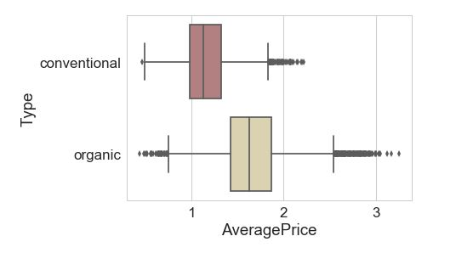
Box plot

Slide 6
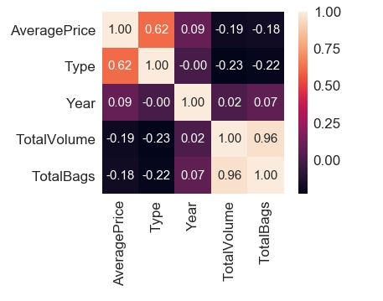
Heat Map

Slide 7
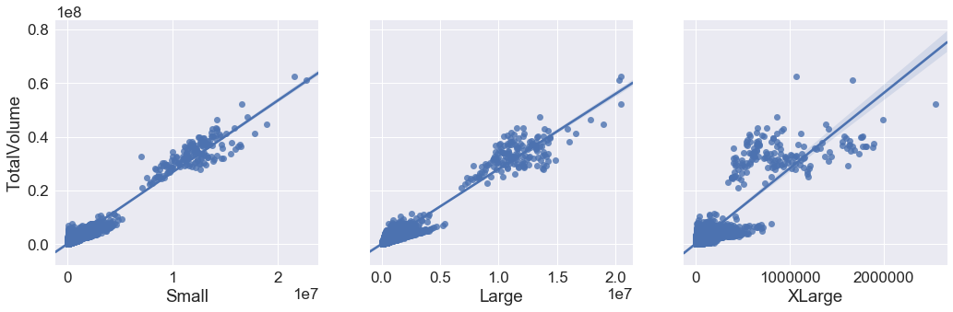
Pair plot
TotalVolume Vs Small, Large & XLarge

Slide 8
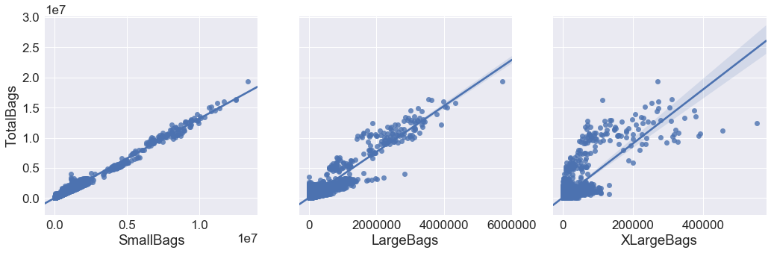
Pair plot
TotalBags Vs SmallBags, LargeBags & XLargeBags

Slide 9
Graph distribution
Comparison of Region Vs AveragePrice
With respect to Years
With respect to Type

Slide 10
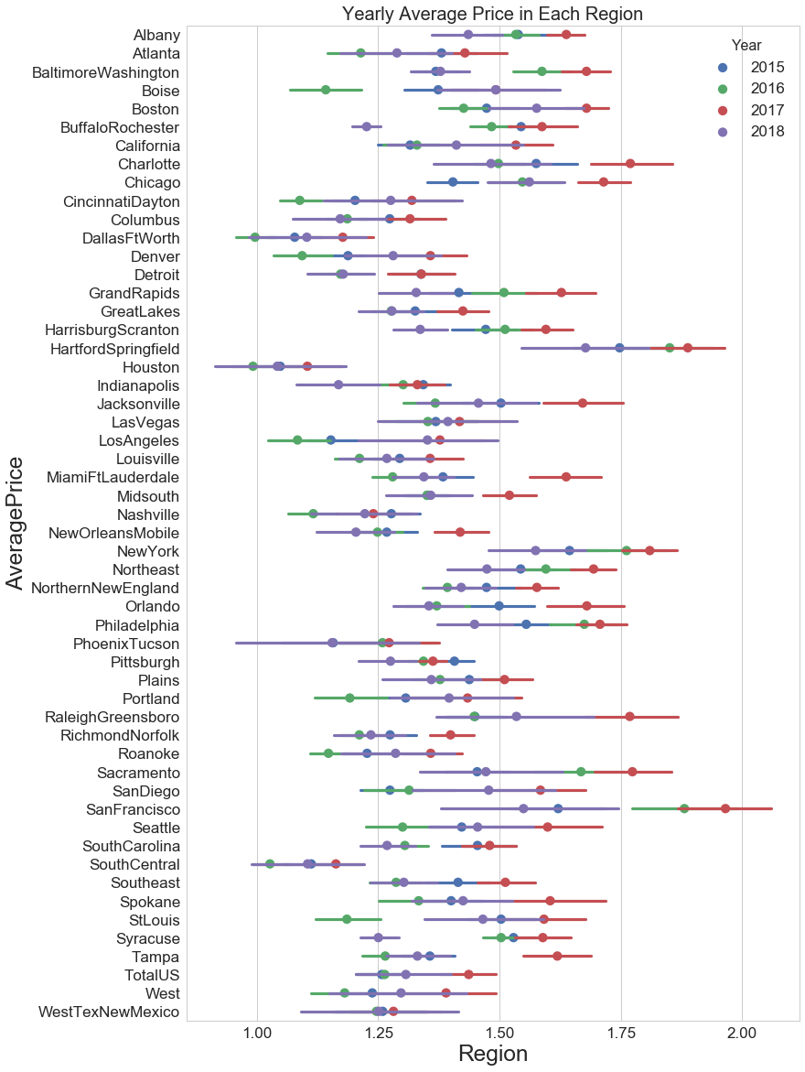

Slide 11
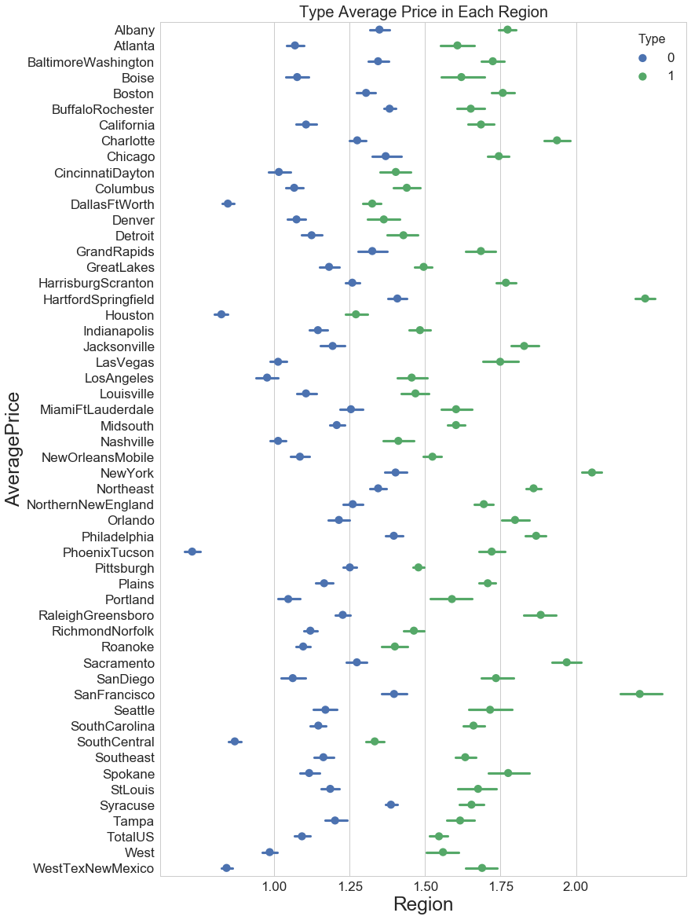

Slide 12
Classifying Type of Avocado
Accuracy score for Logistic Regression test data : 0.74
Accuracy score for test data using Random Forest : 0.99
AUC (area under the curve) for Logistic Regression & Random Forest is 0.96 & 1.00
Higher the accuracy better the model is.

Slide 13
Predicting Average Price of Avocado
Model Evaluation for Linear Regression Model
r_squared for train data 0.40 and adjusted_r_squared for train data 0.40
Model Evaluation for Random Forest Regressor
r_squared for train data 0.95 and adjusted_r_squared for train data 0.95

Slide 14
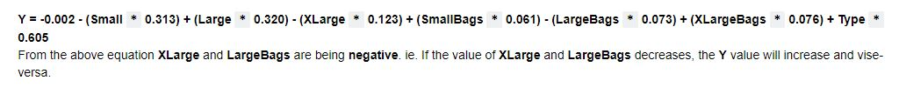
Linear regression

Slide 15
Model Evaluation
Model evaluation using Linear regression metrics
MAE - Training set (0.59) Test Set (0.60)
MSE - Training set (0.60) Test Set (0.60)
RMSE - Training set (0.78) Test Set (0.77)
If we compare RMSE and MSE value, we can conclude that RMSE is greater than MSE.

Slide 16
Conclusion
Columns like Type of avocado, size and bags have impact on Average Price, lesser the RMSE value accurate the model is, when we consider Small Hass in Small Bags.
Random forest Classifier has more accuracy than Logistic regression model for this dataset , accuracy is 0.99 it may also denote it is overfitting as it even classifies the outliers perfectly.
Random forest classifier model predicts the type of Avocado more accurately than Logistic regression model.
Random Forest Regressor model predicts the average price more accurately than linear regression model.

Slide 17
Thank you

